Slide 1
Introduction
This project aims to provide a microcontroller-based system that will help users to automate tasks in their daily work in their household. The system implemented through this project is an automated Home Assistance system that shall automate tasks.
The features of the system are:
● Motion-based modules that will automatically turn the lights and fans on/off depending on if people are in the room
● A gas sensor-based component to detect gas leaks in the house.

Slide 2
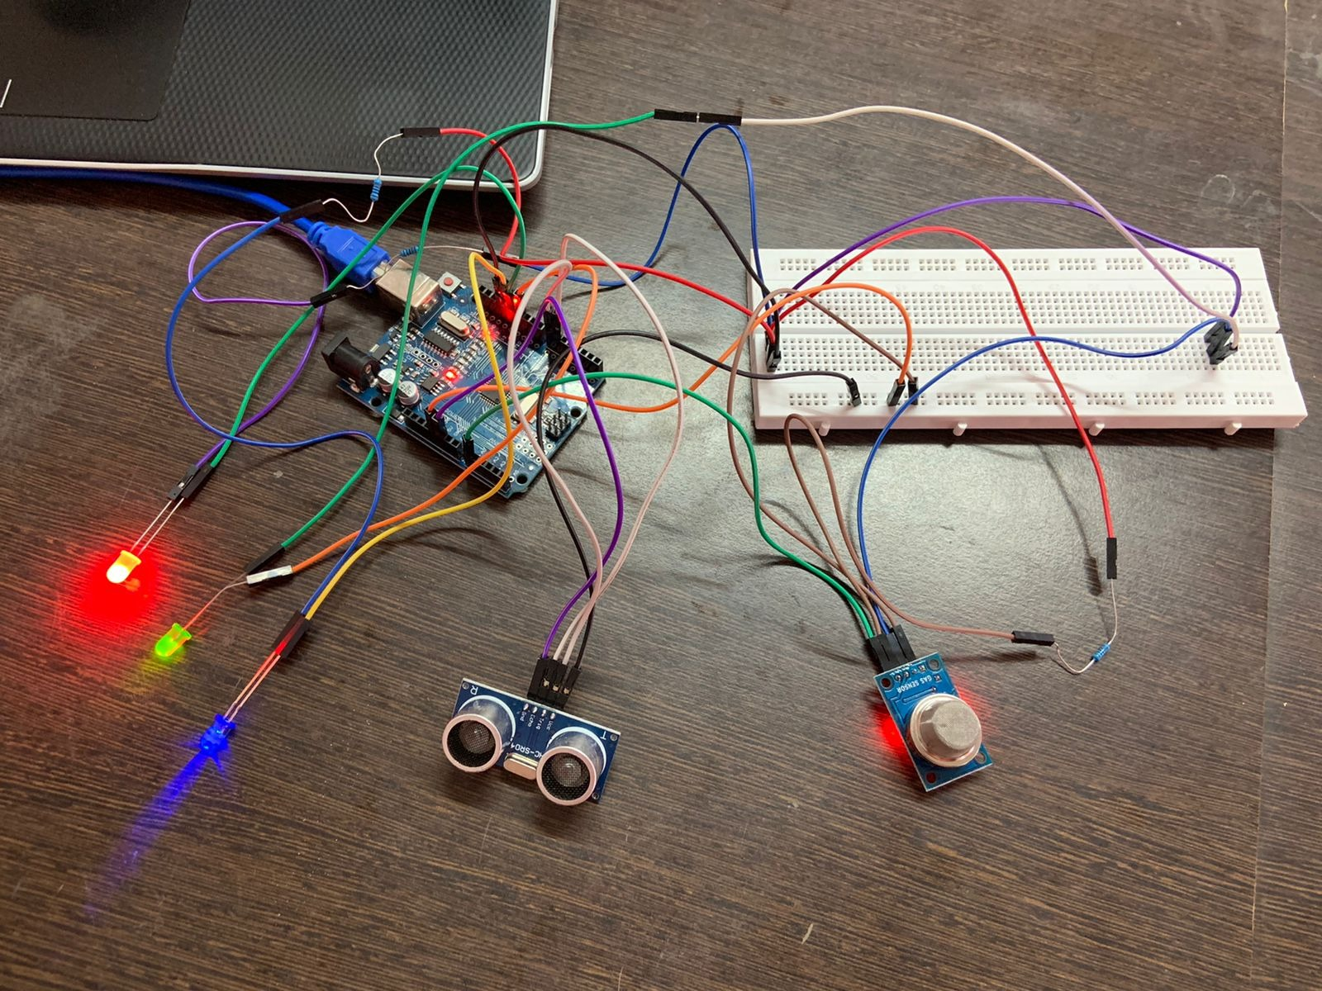
Hardware Circuit

Slide 3
Code
void setup()
{
pinMode(9, OUTPUT);
pinMode(A0, INPUT);
pinMode(lp, OUTPUT);
pinMode(lp2, OUTPUT);
pinMode(lp3, OUTPUT);
Serial.begin(9600);
}
int Value;
int PreviousValue = 90;
const int pingPin = 7; // Trigger Pin of Ultrasonic Sensor
const int echoPin = 6; // Echo Pin of Ultrasonic Sensor
int lp = 13, lp2 = 12, lp3 = 11;

Slide 4
void loop()
{
char gas[] = "Gas sensor Value = "; // create a string
PreviousValue = Value;
Value = analogRead(A0);
Serial.print(gas);
Serial.println(Value);
delay(1000);
digitalWrite(11, HIGH);
if (Value > PreviousValue)
{
digitalWrite(11, HIGH);
}
else
{
digitalWrite(11, LOW);
}

Slide 5
long duration, inches, cm;
pinMode(pingPin, OUTPUT);
digitalWrite(pingPin, LOW);
delayMicroseconds(2);
digitalWrite(pingPin, HIGH);
delayMicroseconds(10);
digitalWrite(pingPin, LOW);
pinMode(echoPin, INPUT);
duration = pulseIn(echoPin, HIGH);
cm = microsecondsToCentimeters(duration);
char dist[] = "Distance between human and ultrasonic sensor = ";
Serial.print(dist);
Serial.print(cm);
Serial.print("cm");
Serial.println();

Slide 6
if (cm <= 50)
{
digitalWrite(lp, HIGH);
if (cm <= 40)
digitalWrite(lp2, HIGH);
else
digitalWrite(lp2, LOW);
}
else
{
digitalWrite(lp, LOW);
}
delay(100);
}
long microsecondsToCentimeters(long microseconds)
{
return microseconds / 29 / 2;
}

Slide 7
Output
When ultrasonic sensor detects anything below 50cm, red light will be on till power goes off. If it detects anything less than 40cm, blue light turns on else blue light turns off. If the gas value increases green light turns on or it will be in off mode

Slide 8
References
B. Evans - Arduino Programming Notebook-Creative Commons (2008)
https://www.tutorialspoint.com/arduino/index.htm
https://docs.arduino.cc/tutorials

Slide 9
Thank you

